Slide 1
Simple Harmonic Motion

Slide 2
13.7When a body of unknown mass is attached to an ideal spring with constant 120 N/m, it is found to vibrate with a frequency of 6.00 Hz. Find (a) period of the motion;
(b) the angular frequency;
(c) the mass of the body.

Slide 3
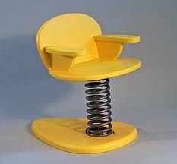
13.15. This procedure has actually been used to “weigh” astronauts in space. A 42.5 kg chair is attached to a spring and allowed to oscillate. When it is empty, the chair takes 1.30 s to make one complete vibration. But with an astronaut sitting in it, with her feet off the floor, the chair takes 2.54 s for one cycle. What is the mass of the astronaut?

Slide 4
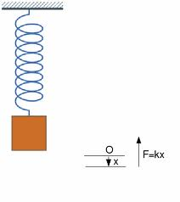
13.19 A 1.50 kg mass on a spring has displacement as a function of time given by the equation .
Find (a) the time for one complete vibration;
(b) the force constant of the spring;
(c) the maximum speed of the mass;
(d) the maximum force on the mass;
(e) the position, speed and acceleration of the mass at t=1.00s.

